Slide 1
OCN Presentation on Optical joints
Presented by : Name SAP ID BE-EXTC-1
Sarfaraj 60002160002
vedant Awasthi 60002160003
atharv bagde 60002160004
viren baria 60002160005

Slide 2
Contents
Sr No. Title Page No.
Why do we need joints? 3
Types of Fiber Joints 4
Concern about Joints 5
Fresnel Loss 6
Fiber parameter mismatch 8
Fiber core misalignment 10

Slide 3
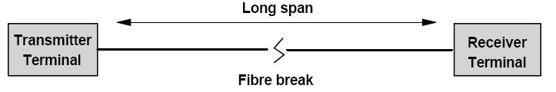
Why do we need joints ?
Optical fibers are generally installed as single cable of certain length (about 2km), but for longer distances joining of these single cables is required.
For repair and replacement of damaged fiber.
For connecting the fiber to terminal equipment, for test purpose.
All of the fiber cable in a building cannot be installed as one continuous cable, joints are needed to complete network cabling.

Slide 4
Types of Fiber joints
For connecting two ends of a fiber we need joints and the two major types are:
Fiber Splices
These are permanent or semi-permanent joints.
E.g. Electrical Soldered joints.
Demountable fiber connector or simple connector
These are removable or temporary joints.
E.g. Electrical plugs and sockets.

Slide 5
Concern about Fiber joints
The ideal purpose of fiber joints is to couple or transport all the light from one fiber to the adjoining fiber.
But, it is not possible to attain 100% light transmission from one fiber to another, due to power loss at joints.
The fiber joint loss can be categorized into three types as:
Fresnel Loss
Fiber parameter mismatch
Fiber core misalignment

Slide 6
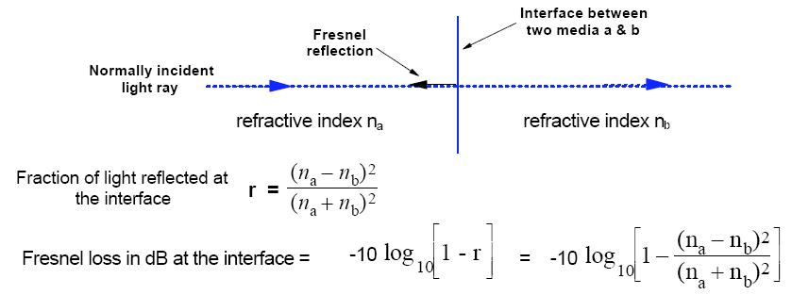
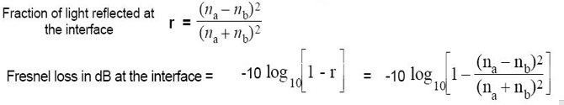
Fresnel loss
Fresnel loss or Return loss is caused due to step change in refractive index at the jointed interface, even when two jointed fiber ends are smooth and perpendicular to fiber axis and the two fiber axes are perfectly aligned and a small portion of light reflects back into the transmitting fiber.
The light which is reflected back into the source fiber is lost. This reflection loss, called Fresnel reflection, occurs at every fiber interface.

Slide 7
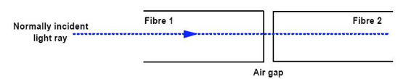
Fresnel loss (contd)
Prevention of Fresnel Loss:
To reduce the amount of loss from Fresnel reflection, the air gap can be filled with an index matching gel.
The refractive index of the index matching gel should match the refractive index of the fiber core.
Index matching gel reduces the step change in the refractive index at the fiber interface.

Slide 8
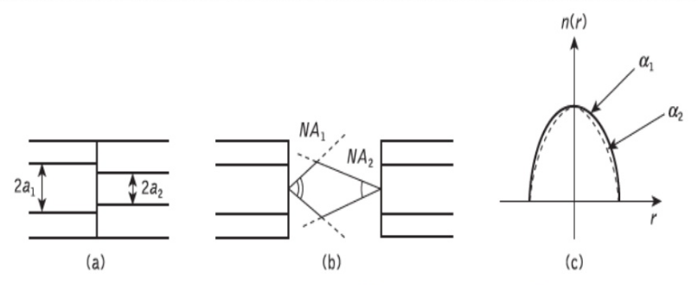
fiber parameter mismatch
Loss due to deviations in the geometrical and optical parameters of the two jointed fibers. The problems may occur for –
(a) Different core and/or cladding diameters
(b) Different NA and/or relative refractive index differences
(c) Different refractive index profiles
By using the same fibers to keep this loss at minimum.

Slide 9
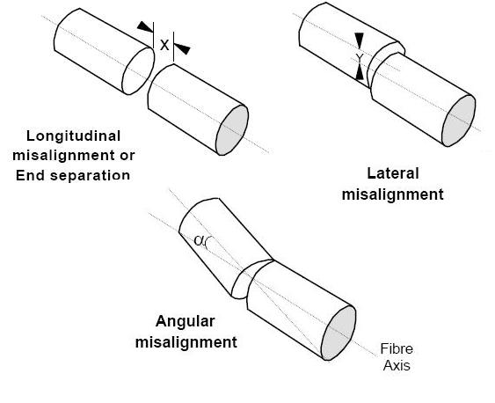
fiber Core misalignment
Loss due to misalignment of the core of the two optical fibers. As misalignment can occur in three dimensions –
The separation between the fibers (longitudinal misalignment)
The offset perpendicular to the fiber core axes (lateral/radial/axial misalignment)
The angle between the core axes (angular misalignment)

Slide 10
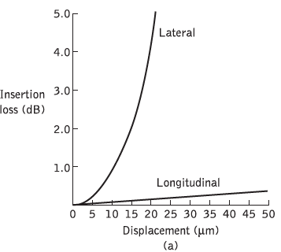
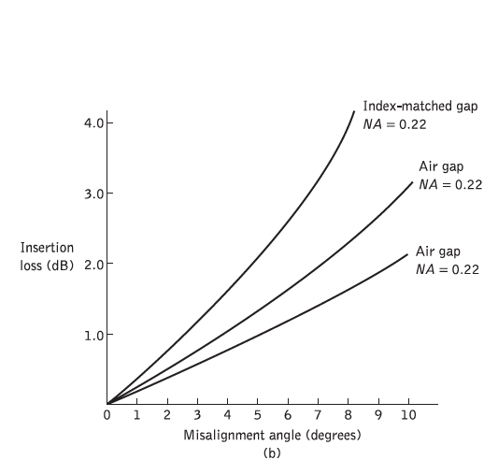
fiber Core misalignment (contd)
Optical losses resulting from these three types of misalignment depend upon the fiber type, core diameter and the distribution of the optical power between the propagating modes.
(a) insertion loss due to lateral and longitudinal misalignment for a graded index fiber of 50 μm core diameter. (b) insertion loss due to angular misalignment for joints in two multimode step index fibers with numerical apertures of 0.22 and 0.3.

